Slide 1

DSA
Week 3
Big-O Notation
Data Structures and Algorithms (DSA)
Prescribed Module/Elective
Diploma in IT, ISF, FI
Year 2 (2018/19), Semester 4

Slide 2
Topics
Introduction to Asymptotic Analysis
Big-O Notation

Slide 3
1. Introduction to Asymptotic Analysis
In Data Structures and Algorithms, the efficiency can be measured in terms of:
Time Complexity
Space Complexity
Sometimes we need to seek a tradeoff between the two.
Complexity:
Rate at which the storage or time grows as a function of the problem size.
Complexity is dependent on several factors.
Machine used to execute the program, compiler used to construct the program etc
In DSA we are interested in the inherent complexity of the program

Slide 4
1. Introduction to Asymptotic Analysis
Asymptotic Analysis
As the problem size grows to infinity, the complexity can be expressed as a simple proportionality to some known function.
describes limiting behaviour
Allows for classification based on growth rates.
Definition:
T(n) = O(f(n))
if and only if there are constants c₀ and n₀ such that T(n) <= c₀ f(n) for all n >= n₀
Read as "T of n is in Big Oh of f of n.“
Big-O is sometimes known as “upper bound” on the complexity.

Slide 5
1. Introduction to Asymptotic Analysis
There are other related notations: o, Ω, ω, and Θ to describe other types of bounds on the asymptotic growth rate.

Slide 6
2. Big-O Notation
Definition:
T(n) = O(f(n))
if and only if there are constants c₀ and n₀ such that T(n) <= c₀ f(n) for all n >= n₀
Eventually, c₀ f(n) will exceed T(n) for some constant c₀
E.g. We can say n² + 2n = O(n²⁰), but we usually choose the limiting function f(n) to be as small as possible, i.e. n² + 2n = O(n²) as n² will dominate the growth as n increases.

Slide 7
2. Big-O Notation: Common Functions
T(n) = O(1) constant growth
T(n) does not grow at all as a function of n, i.e.it is a constant.
E.g. array access is independent of size of the array.
T(n) = O(n) linear growth
T(n) grows linearly or proportionally with n
E.g. looping through all elements in a 1-D array
T(n) = O(n^{k}) polynomial growth
T(n) grows proportionally to the k-th power of n.
E.g. selection sort algorithm is O(n²)

Slide 8
2. Big-O Notation: Common Functions
T(n) = O(log n) logarithmic growth
T(n) grows proportional to base 2 logarithm of n.
E.g. Binary Search
T(n) = O(n log n) log linear/ linearithmic growth
T(n) grows linearly or proportionally to n times base 2 logarithm of n.
E.g. Merge Sort
T(n) = O(2^{n}) exponential growth
T(n) grows exponentially.
Most feared growth pattern in CS!
E.g. Brute-force/Exhaustive search, Travelling Salesman problem using Dynamic Programming

Slide 9
2. Big-O Notation: Common Functions
Arranged In increasing order:
O(1), O(log(n)), O(n log(n)), O(n²), O(n³), ... , O(2^{n}).

Slide 10
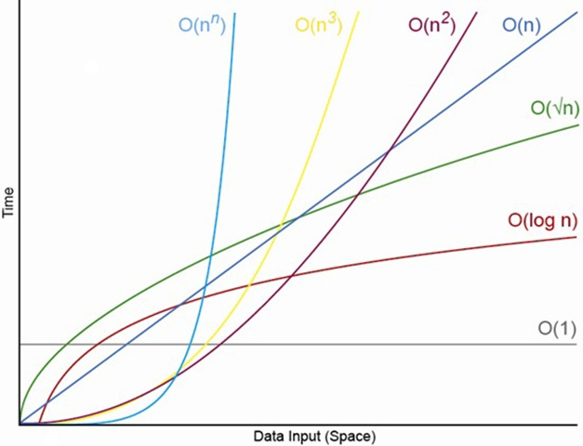
2. Big-O Notation: Common Functions

Slide 11
Topics
Big O Notation
Asymptotic Analysis

